Slide 1

MENTORNESS
NAME : SHYAM A. KALARIYA
STUDY : 6TH SEM (COMPUTER ENG. )
MACHINE LEARNING INTERNSHIP
PROBLEM STATEMENT :
T-20 WORLD CUP 2022 DATA ANALYSIS

Slide 2

T-20 World Cup 2022 Data Analysis
Dive into the thrilling world of the 2022 T20 World Cup with a comprehensive data science analysis. Uncover insights, patterns, and trends that will captivate cricket enthusiasts and provide valuable strategic guidance for future tournaments.

Slide 3
Introduction and Overview
Embark on an illuminating journey through the captivating world of the 2022 T20 World Cup. This comprehensive data analysis will uncover the nuances, trends, and strategic insights that captivated cricket enthusiasts worldwide. Dive deep into the dataset, exploring the game's complexities to provide valuable guidance for future tournaments.

Slide 4
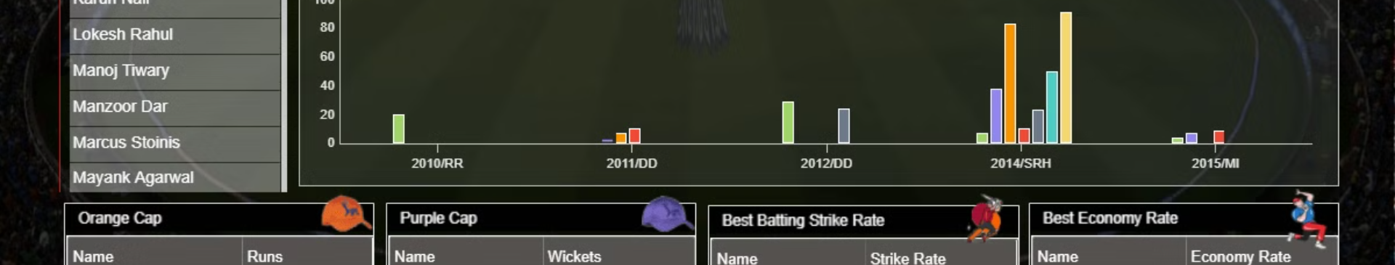
Data Exploration and Preprocessing
Comprehensive data extraction from diverse sources: match scorecards, player statistics, team analytics, and contextual metadata.
Rigorous data cleaning and normalization, handling missing values, outliers, and formatting inconsistencies to ensure data integrity.
Exploratory data analysis to uncover patterns, trends, and relationships within the dataset, leveraging visualizations and statistical techniques.

Slide 5
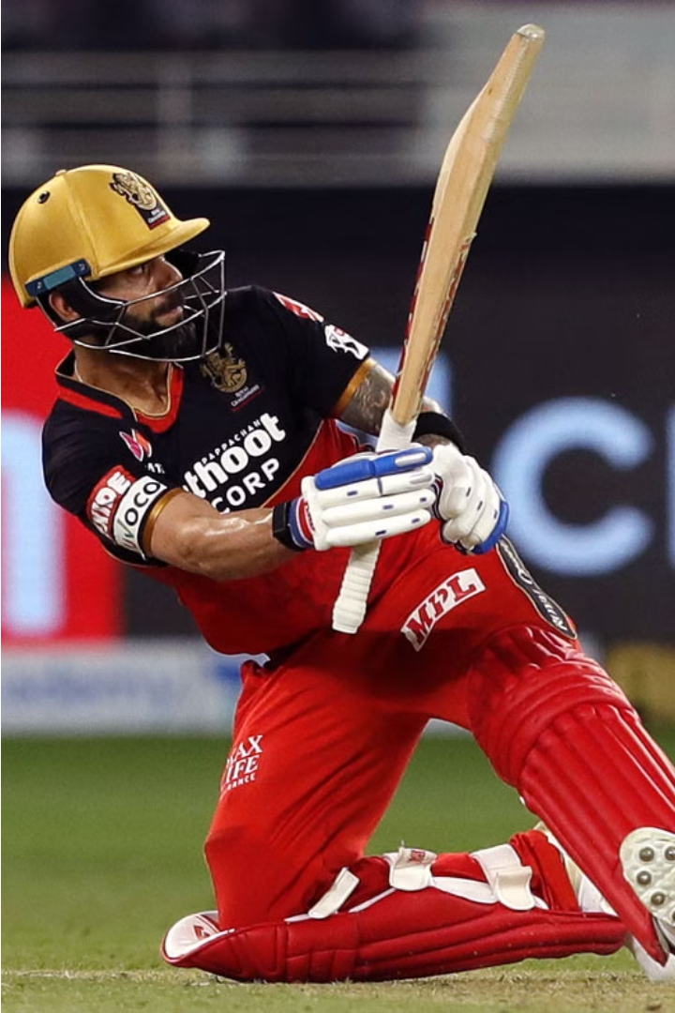
Batting Performance Analysis
Dive deep into the captivating world of batting heroics at the 2022 T20 World Cup. Explore the game-changing contributions of top-order batters, middle-order anchors, and power-hitters who ignited the tournament with their explosive displays.

Slide 6
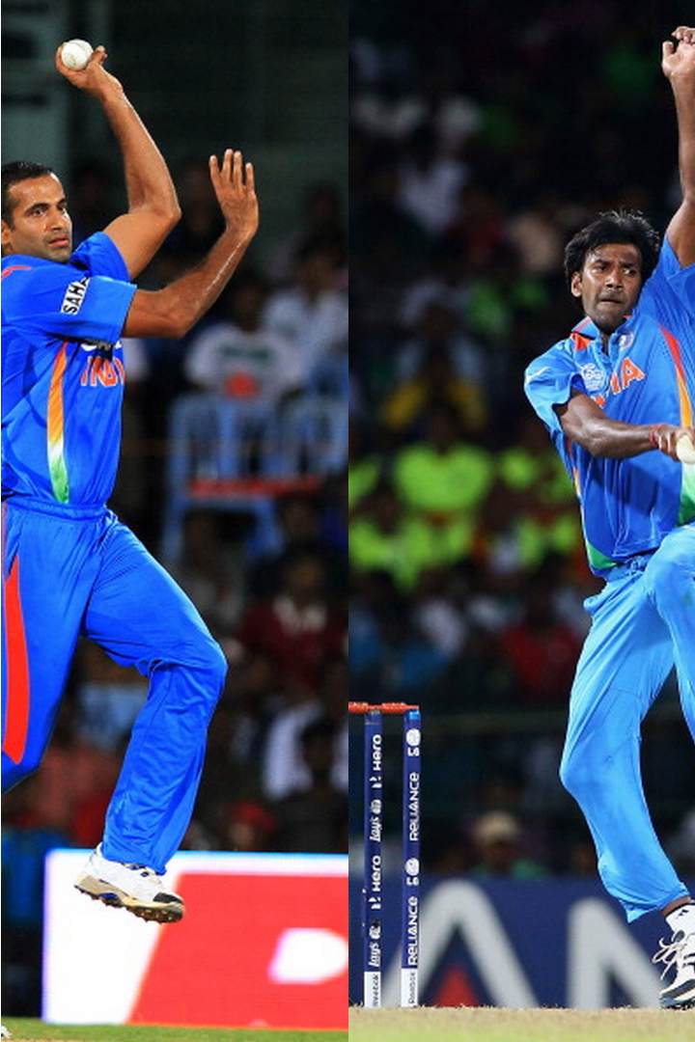
Bowling Performance Analysis
Unravel the captivating tales of the 2022 T20 World Cup's bowling elite. Witness the strategic brilliance of yorker specialists, swing masters, and cunning spinners who bamboozled batters and spearheaded their teams' triumphs through disciplined lines and relentless pressure.

Slide 7
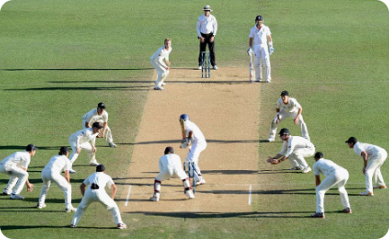
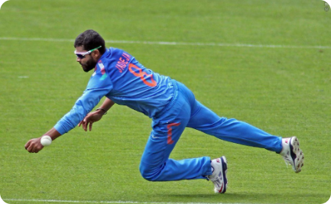
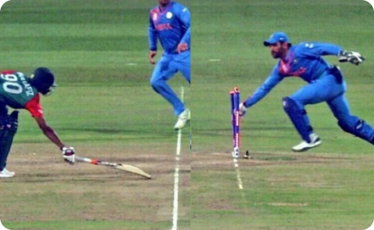
Field Performance Analysis
Electrifying Fielding Displays
Ground Fielding Mastery
Decisive Run-outs
Precise throws and lightning-quick reactions resulted in game-changing run-outs, as fielders demonstrated their prowess in the crucial moments, turning the tables on their opponents.
The 2022 T20 World Cup witnessed unparalleled athleticism on the field, with acrobatic catches, lightning-fast reflexes, and pinpoint throws that left spectators in awe.
Quick feet, agile movements, and relentless determination characterized the ground fielding efforts, with players diving, sliding, and snatching boundaries to turn the tide of matches.

Slide 8
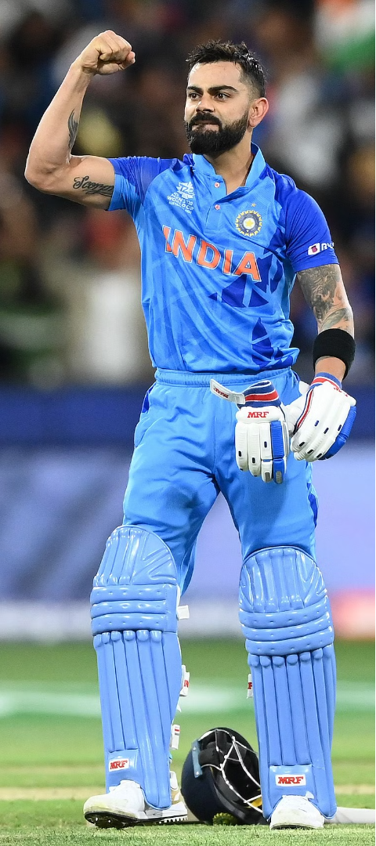
Player Contribution Evaluation
1
Individual Player Analytics
Dive deep into the comprehensive player statistics, uncovering the game-changing performances, clutch moments, and consistent contributions that shaped the 2022 T20 World Cup.
2
Player Impact Assessment
Analyze the pivotal roles played by each cricketer, evaluating their influence on match outcomes, momentum shifts, and team success through advanced impact metrics and visualization tools.
3
Standout Performers
Identify the tournament's most valuable players, the match-winners, and the unsung heroes whose contributions transcended the scoreboard, inspiring their teams and captivating audiences.

Slide 9
Team Dynamics and Strategies
Team Cohesion
Captaincy Influence
Adaptability
Momentum Shifts
Seamless integration of diverse playing styles and skill sets enabled teams to complement each other's strengths, fostering a unified approach that proved crucial in high-pressure situations.
Teams that demonstrated the ability to adapt their game plans based on pitch conditions, opposition strengths, and situational demands emerged as the most successful, outmaneuvering their rivals in the race for the title.
Astute captaincy decisions, from field placements to bowling changes, showcased the tournament's strategic masterminds who steered their teams through the ebb and flow of intense matches.
Momentum swings, triggered by game-changing moments, saw teams seize control, then scramble to regain it, ultimately deciding the outcome of closely contested encounters.

Slide 10
Match Outcome Prediction
1
Predictive Analytics
2
Win Probability Estimates
Leveraging advanced statistical models and machine learning algorithms to forecast the likely outcome of T20 World Cup matches, incorporating factors such as team form, player performances, pitch conditions, and historical trends.
Developing dynamic in-game win probability models that analyze the ebbs and flows of a match, providing real-time insights into each team's chances of emerging victorious as the contest unfolds.
3
Key Momentum Drivers
4
Scenario Simulations
Identifying the pivotal moments, game-changing plays, and strategic decisions that significantly influence the course of a match, enabling accurate forecasting of the eventual winner.
Running extensive simulations of potential match scenarios to test the robustness of predictive models, accounting for the inherent unpredictability and volatility of T20 cricket.

Slide 11
Statistical Insights and Trends
$2.5B
250K
127
Prize Money
Peak Viewership
Sixes Scored
The record-breaking $2.5 billion prize pool for the 2022 T20 World Cup underscored the immense commercial and global appeal of the tournament.
The thrilling final between England and Pakistan drew a staggering peak viewership of over 250,000 spectators, showcasing the tournament's unparalleled popularity.
The 2022 edition witnessed a remarkable tally of 127 sixes, captivating fans with an abundance of big-hitting and boundary-laden action.
Beyond the on-field heroics, the 2022 T20 World Cup also delivered a treasure trove of statistical insights that shed light on the game's evolving dynamics. From record-breaking prize money to soaring viewership figures, the tournament's data-driven story painted a vivid picture of cricket's global dominance.

